Slide 1
FAA Overview of UAS Integration Planning
Strategies and Approaches

Slide 2

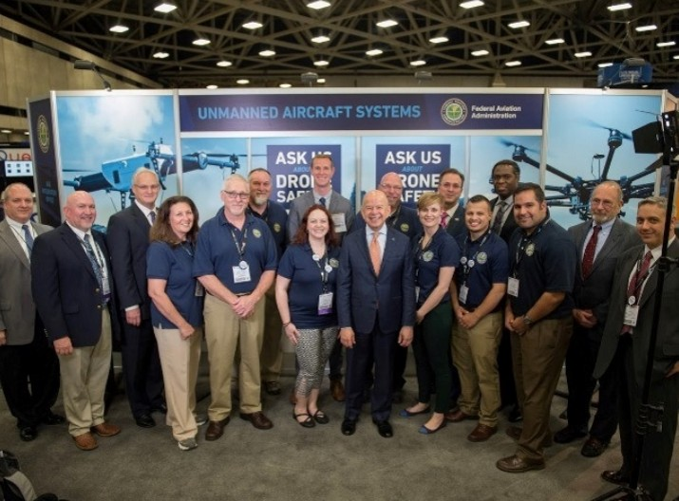
Overview
The FAA UAS Integration Strategy
  The Goal, The Challenge, The New Paradigm
  The Path to Path Integration
  Developing Strategies
Building the Agency Infrastructure and Technology Platform
  The Necessity of Innovation
  Building Blocks to Innovation
Working With Industry
Rulemaking
International Partnerships and Harmonization
Non-Regulatory Mechanisms that Advance UAS Integration
Lessons Learned

Slide 3
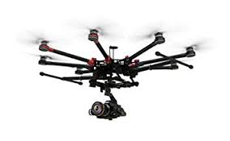
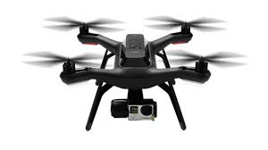
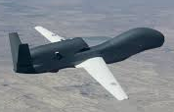
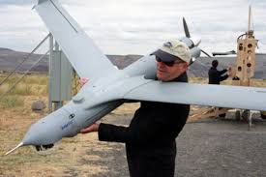

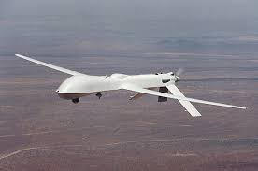
The Goal
The FAA will provide a clear path to UAS operations in the National Airspace System that will be available to every UAS operator and every FAA employee. UAS integration will be accomplished by implementing a full risk-based regulatory framework.
…BUT HOW DO WE GET THERE?

Slide 4








The Challenge
The New Aviation Community
→
Volume
Pace
New UAS
New UAS Users
Necessitates Scalability and Automation
Technological Innovation

Slide 5
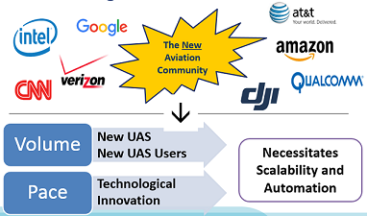
The New Paradigm
Collaboration
Innovation
Shared commitment to safety

Slide 6
The Path to Full Integration
Large UAS / high impact energy
Full UAS Integration
Defining Scalable Safety Assurance Requirements
Passenger Operations
Aeronautical Information Infrastructure for UAS
Small Cargo / Non-Segregated Operations
Automated Low Altitude Authorization
Expanded Operations
Operations Over People
Part 107 Operations
Operations by Exemption
Low-risk, Isolated
Small UAS / low impact energy
Within VLOS or isolated operating area
Beyond VLOS or populated operating area

Slide 7
Developing the UAS Integration Strategy
UAS Strategic Priorities
UAS Strategic Plan
UAS Implementation Plan (IP)
Safety
Adaptability
Global Leadership
Describes the FAA’s high-level strategic vision to meet the challenges posed by the increase in UAS demand and emergent UAS technology
Identifies and describes all agency-wide activities the FAA will perform over the next five years to enable the integration of UAS in the NAS

Slide 8
Aligning Strategic Priorities with IP Goals
Safety | Enable safe UAS operations within the NAS
Enable UAS operations by various communities of users and provide operational services where needed
Develop safety standards for UAS using risk-based decision making
Develop oversight processes to ensure compliance with required standards and regulations
Coordinate FAA research and development activities
Educate the public through community outreach
Adaptability | Create an environment where emergent technology can be safely and rapidly introduced into the NAS
Use performance-based regulations to more quickly adapt to changing technology
Support the development and adoption of industry consensus standards for UAS operations and safety
Evolve existing policies, procedures and systems by leveraging innovation and research
Recruit, train, and develop workforce with the skills and knowledge to address the challenges of UAS and the NAS of the future
Global Leadership | Shape the global standards and practices for UAS through international collaboration
Encourage the development of global industry standards
Provide leadership to promote a risk-based approach and a safety-based UAS culture
Encourage global acceptance of UAS certification, production, and operational oversight through updates to bilateral agreements and other mechanisms

Slide 9
Incremental Expansion of the Regulatory Framework
Integrated NAS Operations
Interaction with ATC
Safety achieved via compliance to conventional aircraft operating principles
Expanded Operations
Expand part 107 to facilitate low altitude operations through Airworthiness certification
Operations Over People
Expand part 107 to incorporate standards for flight over non-participating people -
Part 107 Waivers
Case-by-case Permission for use cases that inform future regulatory expansion
Part 107
  ✓
Regulatory framework for routine sUAS operations
Safety achieved through VLOS and operating limitations
Section 333
  ✓
Case-by-case exemptions granted to existing regulations
Enabled non-recreational UAS operations before Part 107 finalized
Safety achieved with operating conditions and limitations

Slide 10
Developing the Research Strategy in Parallel
Identify essential requirements for the development of a UAS research plan and UAS R&D Roadmap
  Research Plan is integrated across the entire FAA: Aviation Safety, Air Traffic, Airport, Security, and NextGen Organization and various mission critical support offices and technical centers
Partner with the UAS community of stakeholders to communicate and coordinate the FAA’s UAS integration R&D needs

Slide 11
Features of the FAA UAS Research Plan
FAA UAS research planning cycle begins 2+ years before year of execution
R&D needs summarized in this plan are realized post planning cycle and result from
  Completed or ongoing activities: R&D may yield additional questions or follow-on phases
  Updates to the FAA UAS integration path
    Evolution of UAS technology and business cases and increasing demand for expanded operations result in changing UAS integration plans
The FAA continuously re-evaluates its UAS research program to determine the required level of effort and to account for unanticipated changes

Slide 12
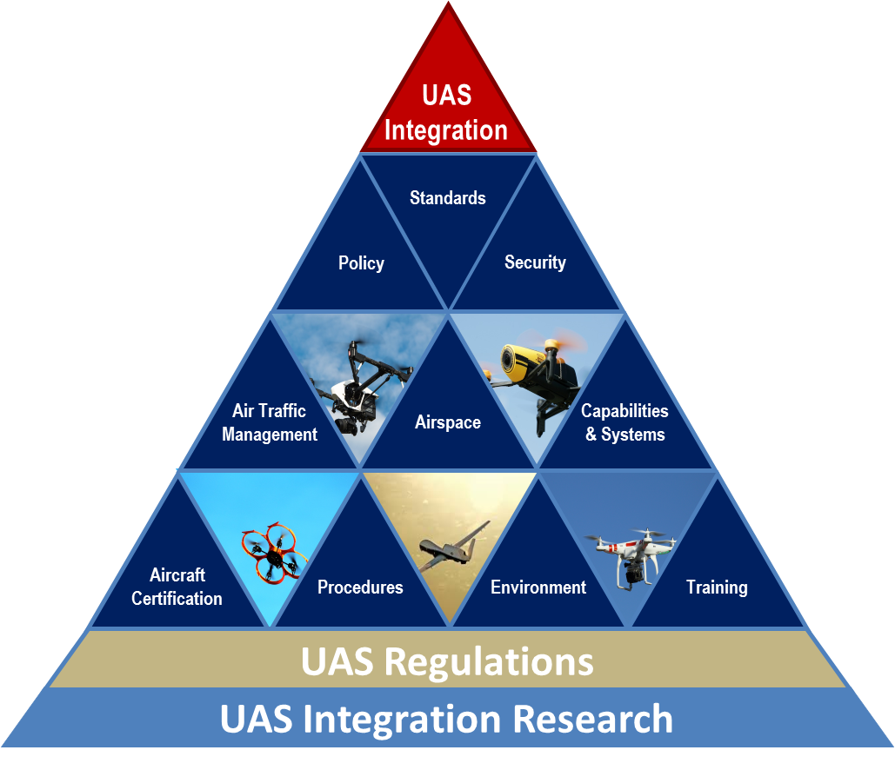
  The Functional Impact of UAS Research
UAS Integration Research
Functional Framework
UAS integration research supports key FAA functions to publish regulations, policy, procedures, and guidance material to support safe and efficient UAS operations in the NAS.
.
Ongoing and planned research activities inform these functional areas

Slide 13
How Research Supports UAS Rulemaking
UAS Implementation Plan – Regulatory Strategy
UAS Over People
Expanded
Operations
Non-Segregated,
Cargo/Passenger
Operations
Small UAS Rule
Identifies
Dependency & Gap Analysis
Informs
Research Requirements
Informs
Enables
Coordination with R&D Partners
(e.g. NASA)
Research Execution
Standards & Certification
Regulations, Policies, Procedures
Produces
Informs and Enables
Research Findings & Data
Informs

Slide 14
Driving Toward Performance-based Regulations
Research → Identifies Risks → Informs Rulemaking
Ground collision studies
  Initial UAS Center of Excellence (ASSURE) research results released in April as part of a series
    https://www.faa.gov/news/updates/?newsId=87950&omniRss=news_updatesAoc&cid=101_N_U
Airborne collision studies
  In peer review
  FAA may consider series results for future certification requirements based on potential lethality

Slide 15
  UAS Research Collaboration & Partnerships
NASA
FAA
Executive
Committees,
Expert Panels
UAS Center
Of Excellence
ASSURE
FAA Research
Needs
Industry
UAS Test
Sites
Domestic
Standards
Groups
Independent
Research
Organizations
International
Standards
Groups

Slide 16
UAS Test Sites
Provide an avenue for UAS industry to conduct more advanced UAS research and concept validation
Nationwide operations at or below 400’ AGL
7 UAS Test Sites:
  University of Alaska
  State of Nevada
  New York Griffiss International Airport
  North Dakota Department of Commerce
  Texas A&M University – Corpus Christi
  Virginia Polytechnic Institute and State University (Virginia Tech)
  New Mexico State University
Notes:
Test Sites selected December 30, 2013
Test Site privacy policy also published December 30
All issued initial COA by August 2014
University of Alaska – operational May 5, 2014
State of Nevada – operational June 9, 2014
New York Griffiss International Airport – operational August 7, 2014
North Dakota Department of Commerce – operational April 21, 2014
Texas A&M University – Corpus Christi – operational June 20, 2014
Virginia Polytechnic Institute and State University (Virginia Tech) – operational August 13, 2014
New Mexico State University – first UAS test site
Four Technical Interchange Meetings held
Data lead assigned to Test Sites – works out of Technical Center in Atlantic City
Test Sites also provided research topics of interest to the FAA in October 2014
North Dakota granted “Broad Area COA” covering most of the state on February 11
All Test Sites granted blanket 400’ COA on September 1, 2015
Broad Area COA covering airspace below 200’ was approved in late May 2015
UAS Test Site Master Agreements for funding research to the UAS Test Sites sent/released on FAA Contract Opportunities website on June 16
All Test Sites hosted Public Meetings in August-September, supported by the FAA

Slide 17






















UAS Center of Excellence
Focus: research, education and training in areas critical to safe and successful integration of UAS into the NAS
Core Team__________________________________________________________________________
Associate Members___________________________________________________________________
Notes:
Selection announced May 8 – Mississippi State University / ASSURE (Alliance for System Safety of UAS through Research Excellence)
Team includes: Drexel University; Embry Riddle Aeronautical University; Kansas State University; Kansas University; Montana State University; New Mexico State University; North Carolina State University; Oregon State University; University of Alabama, Huntsville; University of Alaska, Fairbanks; University of North Dakota; and Wichita State University
Focus: research, education and training in areas critical to safe and successful integration of UAS into the NAS
Initial research in: detect and avoid technology; low-altitude operations safety; control and communications; spectrum management; human factors; compatibility with air traffic control operations; and training and certification of UAS pilots and other crewmembers
Expected to begin research by September 2015 and be fully operational by January 2016
$5 million appropriated by Congress (5 years); will be matched one-by-one by team

Slide 18
Building the FAA’s Infrastructure and Technology Platform

Slide 19
Confronting the Innovation Challenge
The FAA is partnering with industry on the IT back-end to implement innovative solutions that enable UAS operations while meeting FAA needs (data retention, ability to contact an operator/clear airspace).
IT platforms and supporting infrastructure need to be “tied together.”
The goal is to make a “one-stop-shop” for all things UAS in the FAA – registration, accident reporting, waiver and authorization requests, training, and special alerts or notifications.

Slide 20
Necessity of Innovation
FAA Drone Zone
FAA User
Performance Reports
Waivers/Accidents
Authorizations
Registry Lookup
Alerts and Notifications
FAA Air Traffic Control
LAANC Application for Air Traffic
UAS Data Layer
(FAA IT)
LAANC 3rd Party Partner Application
UAS Registration
Part 107 waivers & authorizations (requests and status lookup)
Accident Reporting
Education & Training
Alerts and Communications
UAS Operator

Slide 21

Online UAS Registration
Operators flying under the small UAS rule (part 107) or a public certificate of waiver or authorization must register online
  Operators must provide: email address, physical address, the make, model, and serial number (if available) of each small UAS
UAS over 55 lbs. must use the paper-based registration process
NOTE: Registration will be address in more depth in the “Building Blocks Leading to UAS Integration” section of the Agenda

Slide 22
Building Blocks to Innovation
UAS Facility Maps
  Depict maximum altitudes that FAA may grant controlled airspace access for Part 107 operations without additional safety analysis
  Maps do not authorize operations
    Job aid for airspace authorization
    requests
    Assists the FAA in streamlining
    authorization process
  First phase: 238 Class E airports
    Maps for Class B, C, and D airports
    will be released on a 56-day cycle

Slide 23
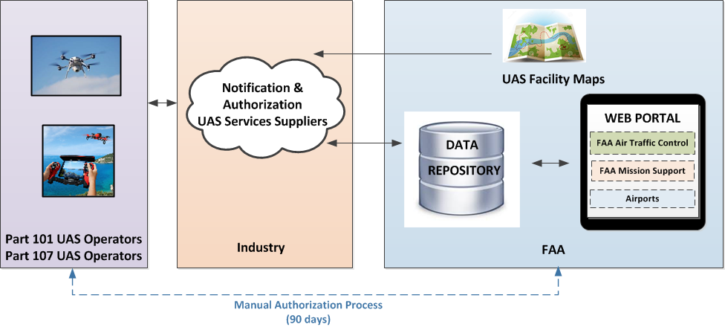
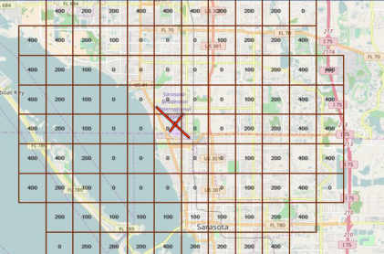
Building Blocks to Innovation, cont.
UAS Low Altitude Authorization & Notification Capability (LAANC)
Facility Maps

Slide 24
Working with Industry

Slide 25

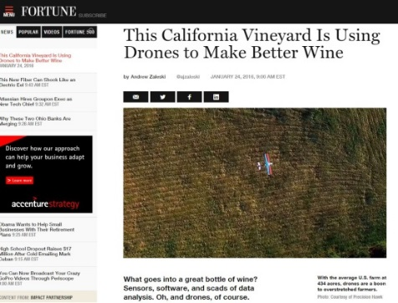



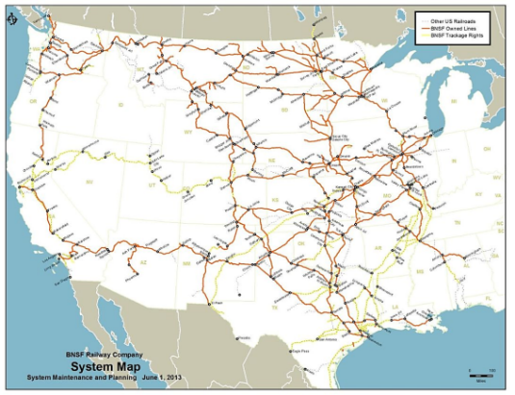
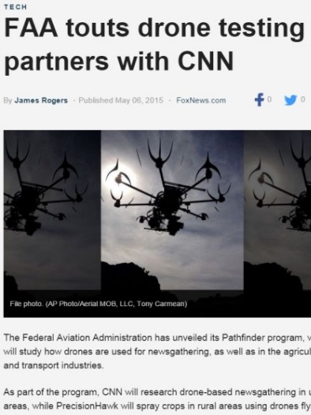
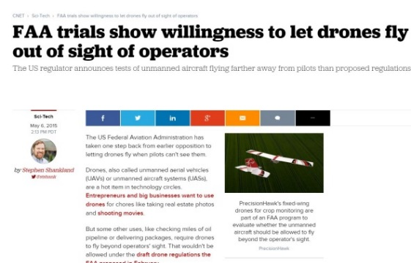

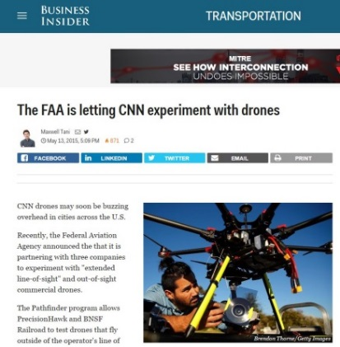
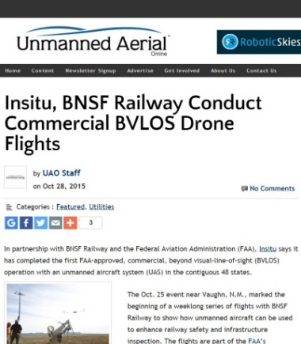
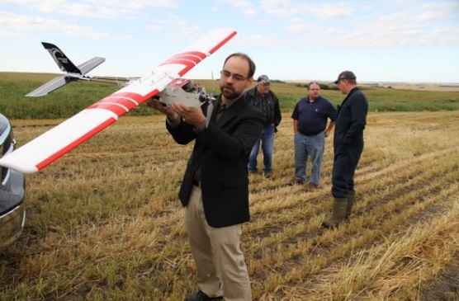
Partnering with three U.S. companies to research UAS operations beyond the scope of the small UAS rule (part 107)
Focus Area Pathfinders
Pathfinder 1: CNN
Pathfinder 2: PrecisionHawk
Pathfinder 3: BNSF
Ops over People
EVLOS Ops
BVLOS Ops
Notes:
A Pathfinder Program enables the FAA to work closely with industry to develop and validate operational concepts for certification, operations, and safety beyond those contained in established or proposed policies and procedures.
Our Focus Area Pathfinder initiatives have laid a lot of groundwork for future regulatory steps.
News media - Operations over people
Precision agriculture – Extended visual line of sight
Critical infrastructure inspection – Beyond visual line of sight
CNN working on operations over people, PrecisionHawk working on extended visual line-of-sight operations, and BNSF working on beyond visual line-of-sight operations, specifically in the environment of right of ways through rural areas.
These kinds of operations – for newsgathering, precision agriculture and surveying, and infrastructure inspection – are what the next steps in integration will enable…

Slide 26
Stakeholder Engagement
Drone Advisory Committee
(DAC)
Unmanned Aircraft Safety Team
(UAST)
Purpose: help prioritize the FAA’s UAS integration activities
35 members
  UAS manufacturers and operators, traditional manned aviation, labor organizations, radio and navigation equipment manufacturers, airport operators, state and local officials
Subcommittee + 3 Task Groups
  Roles and Responsibilities
  Access to Airspace
  UAS Funding
Purpose: gather and analyze data to enhance safety and operations of drones in the nation’s airspace
48 members
  Primarily UAS manufacturers, operators, and data service providers, as well as traditional manned aviation groups
6 Working Groups
  UAS Survey
  UAS Data Management
  UAS Communications
  UAS Loss of Control
  Injury Reduction
  Safety Culture
Notes:
The Drone Advisory Committee is helping us prioritize activities, tackling issues like airspace access, funding, and the role of state and local officials in UAS regulations.
The Unmanned Aircraft Safety Team, or UAST, doesn’t quite have the public visibility of the DAC, but is fundamentally important to pushing the integration envelop forward, and may be of more interest to this committee.
They are an industry-led group focused on using data to develop safety recommendations for industry to voluntarily adopt – basically non-regulatory safety solutions.
They have a number of working groups focused on quite a few activities, but I want to draw your attention to one in particular:
One of the fundamental components of assessing risk is the data analysis that goes into calculating accident and incident rates. At a very simple level, those calculations require a numerator and denominator – how many times did x occur out of all the possible times it could occur?
We’ve got this down pretty well with manned aviation – we have a good understanding of how many planes and operations are going on in the NAS, either because they operator must log them, or we conduct a survey (general aviation) to collect the information
We’ve struggled with adapting this strategy to UAS, in large part because we have almost no information about that denominator – how many UAS are flying in the NAS at any given time, in a day, a month, a year?
The UAS Survey working group is collaborating with FAA’s economists to start tackling this issue – similar to the GA survey, they’re developing a method to survey the UAS operator community about the volume of UAS operations being conducted in the NAS.
It’s no easy or small feat, and we definitely appreciate their willingness to take on such a task.
ADDITIONAL INFO ON UAST WORKING GROUPS
Working groups are focused on:
Developing a UAS survey – similar to the General Aviation Survey, but designed to reach a very different kind of aircraft user
Collecting and managing UAS data – similar to the very successful voluntary data sharing efforts of the Commercial Aviation Safety Team
And communicating to the UAS community – how do we reach this new community with important safety information
Concerns about flyaways and command-and-control failures (as depicted in the news, social media and inferred from the sightings reports) warrant further examination
The UAST has also begun examining the increasing amount of injuries attributed to UAS operations
The Safety Culture working group will be focusing on the gaps between the safety culture of manned and unmanned aviators – the former long established and embedded into the training culture, while the latter is generally unexperienced with the aviation community and its interconnected and interdependent nature

Slide 27
Rulemaking

Slide 28
Working with Industry and the Public
  Pre-Rulemaking Activities & Mechanisms
    International Regulatory Cooperation
      Ensure cooperation in rulemaking projects to facilitate harmonization through bilateral agreements
    Advisory Committee Activities
      Aviation Rulemaking Advisory Committee (ARAC)
        Public meeting with aviation stakeholders that meets 3-4 times per year
      Aviation Rulemaking Committee (ARC)
        Subject focused short-term committee with aviation stakeholders.
        UAS ARCs

Slide 29
Aviation Rulemaking Committees (ARC)
Membership is diverse – aviation, technology, law enforcement, and safety stakeholders
  UAS Identification and Tracking ARC
    Develop recommendations for remote UAS identification and tracking
    Addresses UAS over people safety and security concerns
  UAS in Controlled Airspace ARC
    Identifying gaps in R&D to inform integration
    Recommending prioritized changes/additions to policies and capabilities to achieve integration
    Recommending scenarios encompassing most desired operations

Slide 30

Regulatory Actions – Today and the Future
Hobbyist/Recreational Operations
Small UAS Rule (Part 107)
  In line of sight of operator; Under 55 lbs.; Only during daylight hours at or below 400 feet; Not over people; Remote Pilot Certificate
Operations Over People (107 Expansion)
  Working Regulation Now
Beyond Visual Line Of Sight (Permit to Fly)
  Enable Low Risk, Small UAS First
Integrated/Controlled UAS Ops (TC/PC)
  Changes to ATM and Mature Technology
Future Automation – “Pilotless” Ops
  Only as ATM and Automation Allow
Future
Automation
Hobbyist
Integrated
Operations
Part 107
Expanded
Operations
Future Rulemaking and Waivers
Notes:
Part 107 provisions are designed to minimize risks to other aircraft and people and property on the ground.
The rule requires pilots to keep an unmanned aircraft within visual line of sight.
Operations are allowed during daylight and during twilight if the drone has anti-collision lights.
The rule also address height and speed restrictions and other operational limits, such as prohibiting flights over unprotected people on the ground who aren’t directly participating in the UAS operation.
The rule permits UAS flight in uncontrolled (Class G) airspace without permission from air traffic control. Flights in controlled airspace (Class B, C, D, and E) require authorization from air traffic control.

Slide 31
UAS Operations
Increasing Risk | Aircraft Requirements | UAS Registration | Pilot Requirements | Types of Operation | Airspace Requirements
Part 101 Model Aircraft | UAS < 55 pounds *unless otherwise certified through a CBO | Registration not required* *Voluntary registration encouraged | Community-Based Organization (CBO) standards | Hobby or recreational, VLOS, Part 101 operating rules, CBO standards | Notification requirement within 5 miles of an airport
Part 107 | UAS < 55 pounds | Register through Small UAS Registration Service | Part 107 remote pilot certificate with small UAS rating | VLOS, daytime, Class G, 400 ft, not over people OR waiver provisions | Airspace waiver or authorization for Class B, C, D, E airspace
Section 333 | As specified in exemption | For UAS > 55 pounds, N-number registration required | Part 61 airman certificate | UAS > 55 pounds | Blanket COA or standard COA for specific airspace
Public Aircraft | Self-certification by public agency | For UAS > 55 pounds, N-number registration required | Self-certification by public agency | Public Aircraft Operations (AC 00-1.1A); UAS Test Site Operations | Blanket COA or Standard COA for specific airspace
Experimental Aircraft | Experimental Special Airworthiness Certificate | For UAS > 55 pounds, N-number registration required | Part 61 airman certificate | Research and Development, crew training, and market survey | Standard COA for specific airspace
Type Certificated Aircraft | Restricted type or special class certificate | For UAS > 55 pounds, N-number registration required | Part 61 airman certificate | Specified in operating authorization | Part 91 airspace requirements

Slide 32
International Collaboration

Slide 33

International Partnerships & Harmonization
The FAA’s Global Leadership Initiative emphasizes international collaboration and harmonization
UAS Integration is a GLOBAL CHALLENGE!
Working through International Organizations:
  ICAO
  JARUS (Joint Authorities for Rulemaking on Unmanned Systems)
  RTCA & EUROCAE
  ASTM International
  American National Standards Institute (ANSI)/International Organization for Standardization (ISO)
  CANSO (Civil Air Navigation Services Organization)
JARUS members

Slide 34

International Partnerships & Harmonization
Working with Regional Organizations:
  FAA and SESAR Joint Undertaking Coordination Protocols
    NextGen & SESAR cooperation on UAS concepts and related R&D
  Latin American Civil Aviation Commission
    Conducting seminars and dialogue on common challenges and rulemaking initiatives
  Regulatory Cooperation Council with Canada (RCC)
  UAS Detection
    Evaluating technology solutions for detecting small UAS near airports include partnering on testing in Helsinki, Finland
Engaging in direct dialogue with bilateral partners such as EASA and FATA.

Slide 35

International Partnerships & Harmonization
Leading UAS talks at Major FAA International Events:
  FAA/AUVSI UAS Symposium
  FAA - TCCA Annual Bilateral Meeting
  FAA - Asia-Pacific Flight Standards Meeting
  FAA - Western Hemisphere FAA Flight Standards Meeting
  FAA - International Rotorcraft Safety Conference
  FAA - Asia-Pacific Bilateral Partners Dialogue
  FAA - EASA International Aviation Safety Conference
Engaging Stakeholders at Major International Events:
  AUVSI Xponential – All Things Unmanned
  RTCA Global Aviation Symposium
  International Drone Expo (IDE)

Slide 36


The Big Picture: Collaboration is key!
Ex Com
RTCA
ASTM
Test Sites
UAST
Pathfinders
ICAO
Center of Excellence
Aviation
Rulemaking
Committees
JARUS
DAC
Manage NAS Access
Provide Minimum Standards
Implementation Plan

Slide 37
Non-Regulatory Mechanisms that Advance UAS Integration

Slide 38
The Challenge
The New Aviation Community
New to the Safety Culture
Array of Interests
Diverse
High Volume of Users
Not Familiar with Common Practices

Slide 39

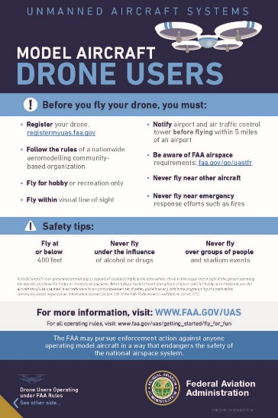

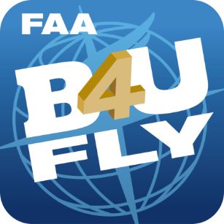
The Need for Effective Communication
Non-Regulatory Mechanisms = “Outreach” campaigns to targeted audiences
Product inserts, flyers, B4UFly app, websites, social media
The FAA has learned this is a key component to UAS safety enhancements.

Slide 40
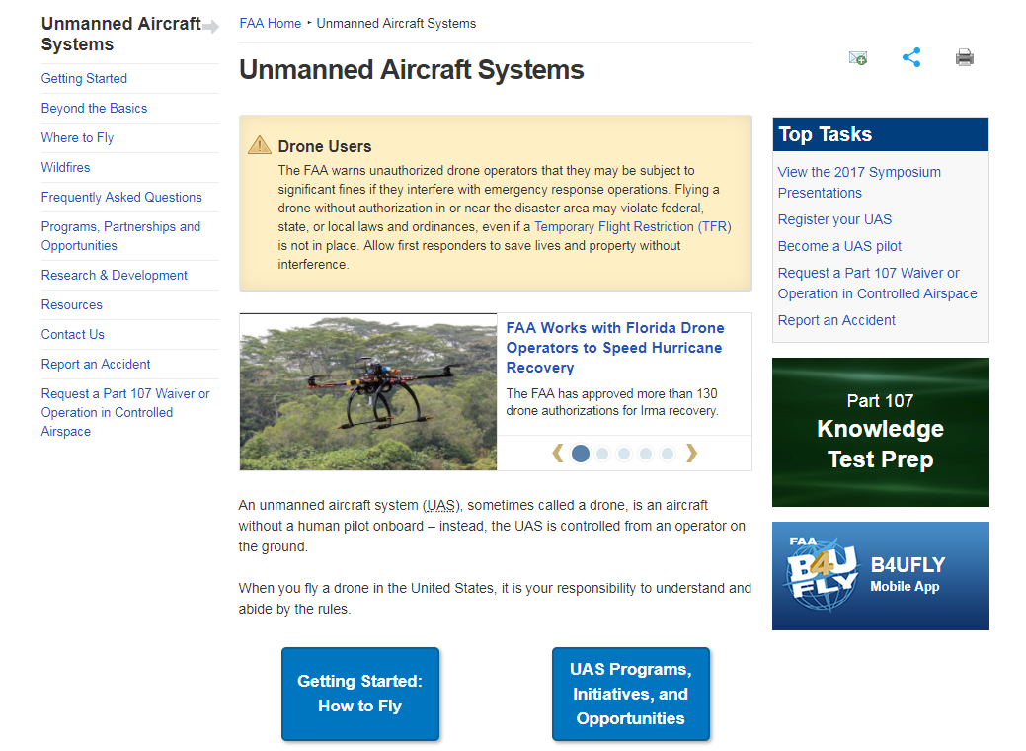
FAA UAS Website – Regulator Transparency
Content updated based on user feedback
Redesigned to be more user
friendly

Slide 41
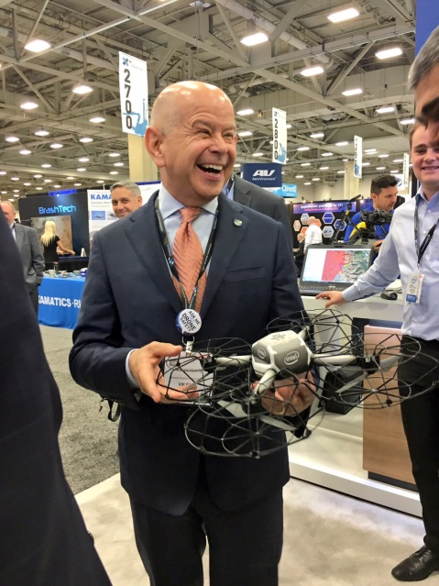
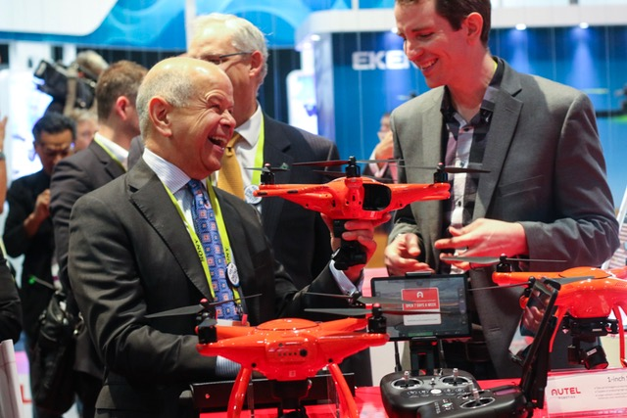

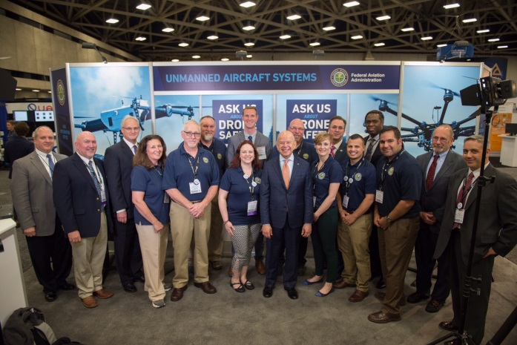
FAA Trade Show Presence
FAA speakers and booth staff
Opportunity to engage with attendees
  Answer questions and listen to feedback

Slide 42
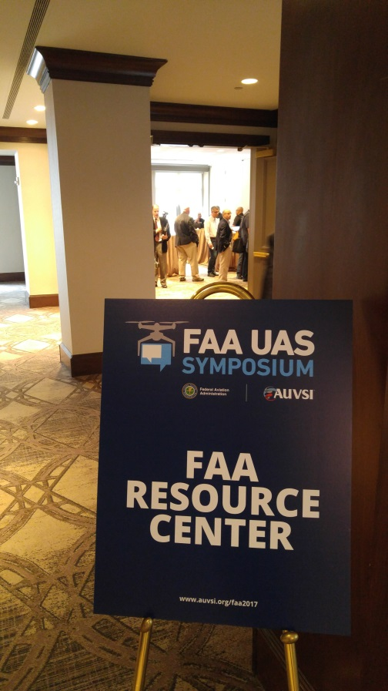
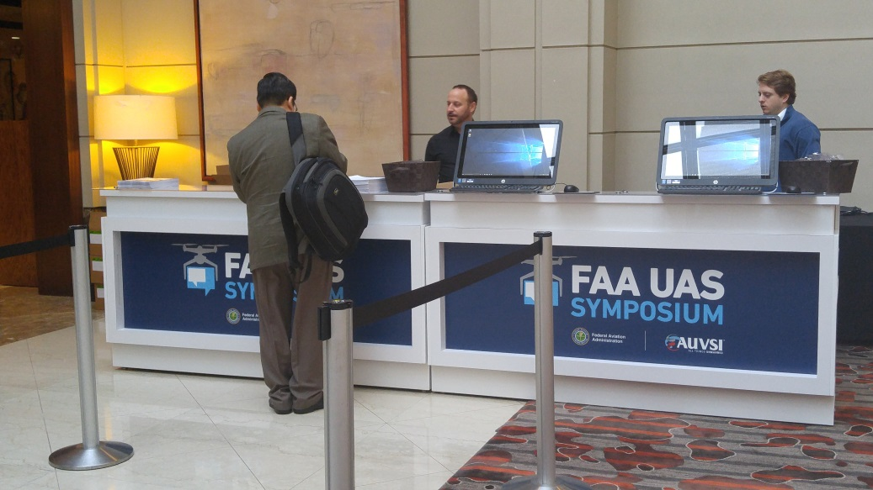
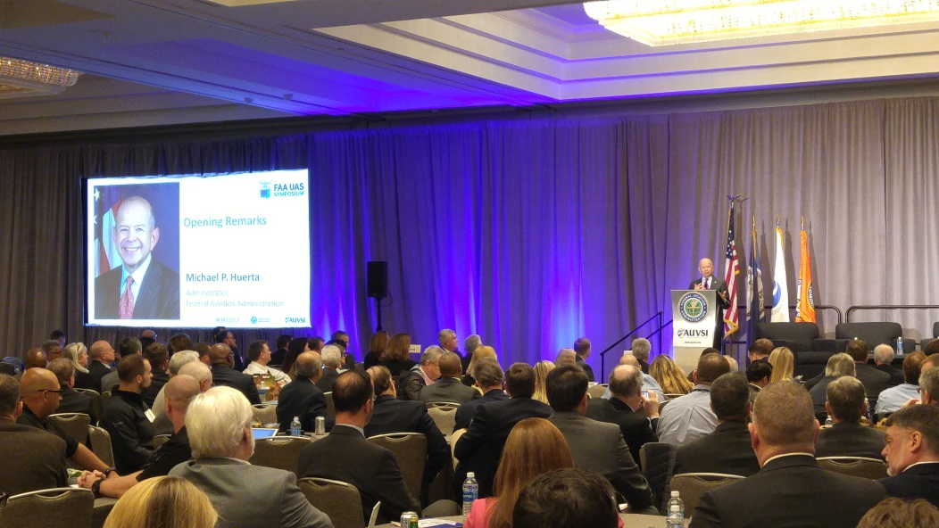
Annual FAA UAS Symposium
Designed to
bring together representatives
from government, industry, and academia
Focus – topics of high interest to the fast-growing UAS community
~ 800 attendees
3 plenary panels, 9 breakout sessions, 10 workshops

Slide 43


Technical Support and Education
Help Desk
Part 107 Webinars
844-FLY-MY-UA UASHelp@faa.gov

Slide 44

Other Stakeholder Outreach
Weekly calls with Aviation Safety Inspectors in Flight Standards District Offices (FSDOs)
Law Enforcement outreach calls and webinars (“411 for 911” series)
External briefings and presentations
  20-25 events per month supported by HQ staff
  8-12 events per month supported by field staff
  1-2 international events per month

Slide 45
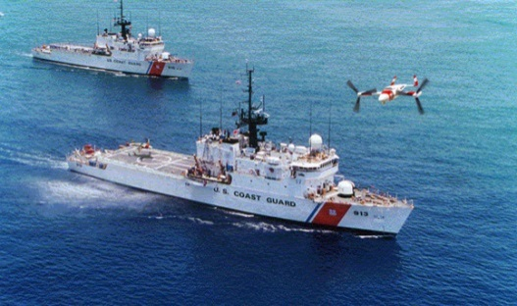
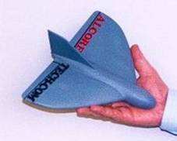
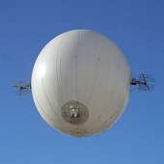

Lessons Learned
Incremental approaches to UAS integration are best
    NOT all-inclusive regulatory solutions
UAS integration vision must be
  Modular
  Scalable
  “Add as-you-go” capable
Integration of legacy users requires planning and prioritization
Partnering with Industry important
  Drone Advisory Committee; ARC; UAST
Security issues must be addressed
Notes:
Pathway to “Yes”
Build number of operations needed to develop comfort with skills and type of operations
Can’t just have grand ambitions because they are:
Hard to execute
Difficult to manage
Partnering with Industry
Regulatory entities must respond and adjust in real-time
The FAA engages with the UAS community to provide a common understanding of goals and constraints and to develop specific standards needed to support operations and approval processes. This engagement provides mutual education of expectations and constraints, and facilitates common approaches and solutions.
One mechanism by which the FAA accomplishes this is through the Drone Advisory Committee (DAC), a federal advisory committee created to assist the FAA prioritize UAS regulatory actions.
The purpose of the DAC is to provide an open venue for FAA and UAS stakeholders to work in partnership to identify and recommend a single, consensus-based set of resolutions for issues regarding the efficiency and safety of integrating UAS into the NAS and to develop recommendations to address those issues and challenges.
The DAC will also provide the FAA with recommendations that may be used for tactical and strategic planning purposes.
The DAC is comprised of senior executives that represent the spectrum of the UAS stakeholder community: unmanned aircraft manufacturers and operators, traditional aviation groups, labor organizations, radio and navigation equipment manufacturers, airport operators and state and local officials.
RTCA, the DAC Secretariat, held the first public meeting on September 16, 2016. The second one was held January 31. Information about the DAC, it’s members and meeting minutes can be found on the RTCA website. http://www.rtca.org/content.asp?pl=216&contentid=216.

